Slide 1
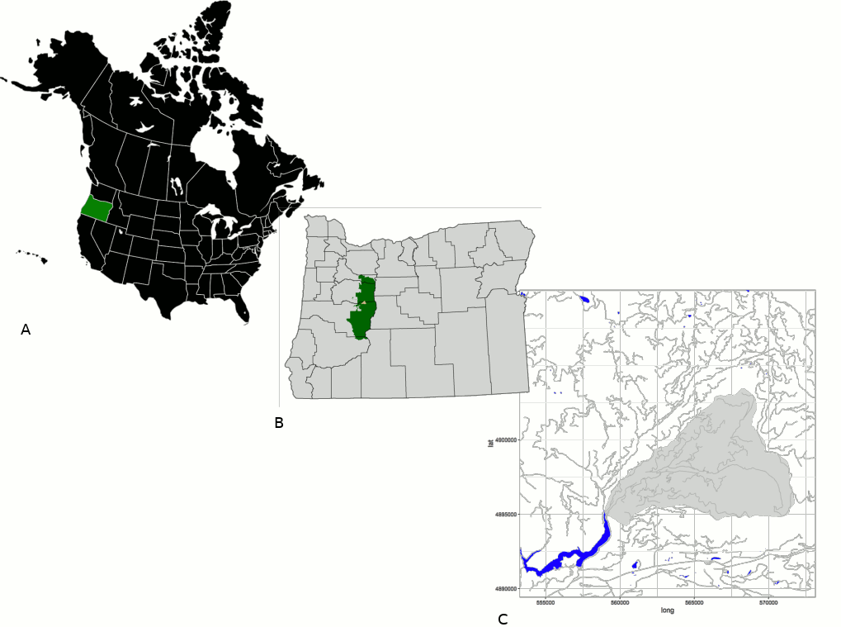
geo-map
(we can include a google earth map here in order to see vegetation and topology in this area)
Our study site is at the HJA Experimental Forest in Oregon, USA. It is a research site in Cascades Mountains. To the west of the experiment forest (triangular gray area on panel C), there are old-growth forest. Within the Experimental Forest, different sites are experiencing different forest management, patched in old-growth forest sites. To the east of the forest, there are a large area of clear-cut lumber yards (?)

Slide 2
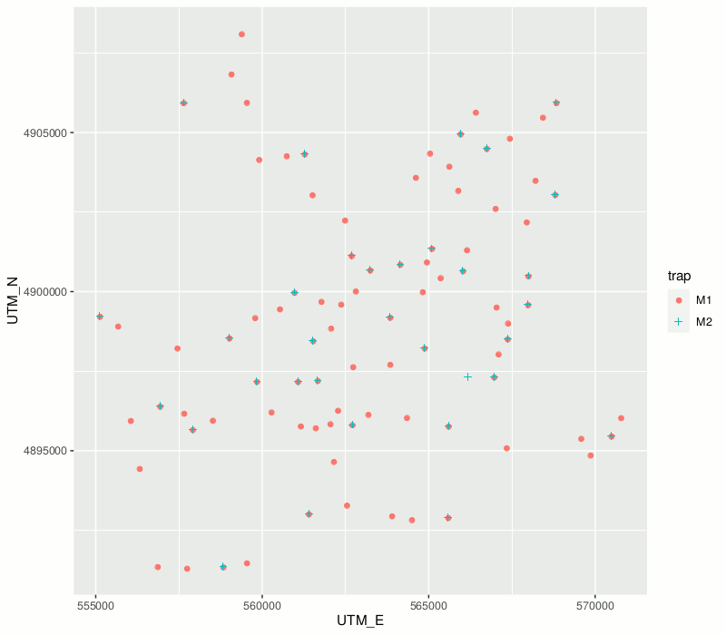
sampling
(draw same HJA shape as in geo-map)
We sampled 94 sampling sites inside and outside the HJA Experiment Forest. We set two Malaise traps ? meters away from each other in each sampling site. We collected data from Malaise traps twice in July and August(?) in 2018.

Slide 3
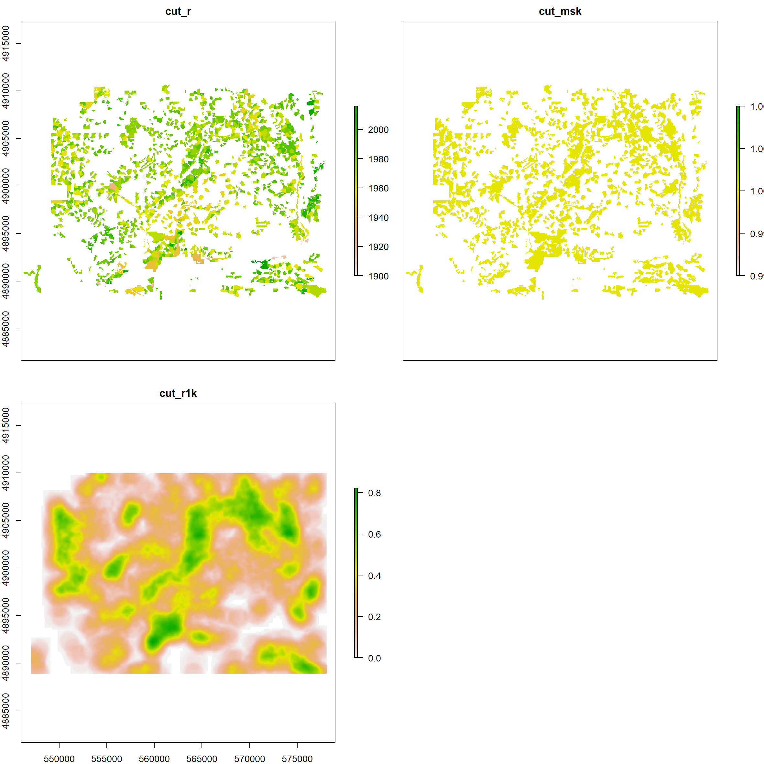
Remote-sensing data
(We can select several most important variables to show here)
We get remote-sensing data covering our sampling points from ?? satellite and DOGAMI lidar (?). Other than raw data of multi-spectra, we calculated some metrics that we thought are important for the invertabrate communities, e.g. roughness and topology.

Slide 4
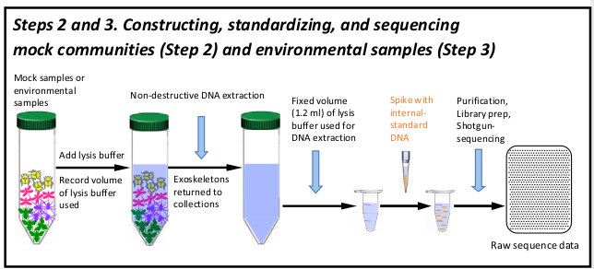
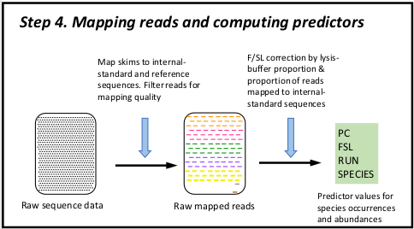
Gene extraction and bioinformatics
(From Ji et al. 2019 Spikepipe. I'm not sure if we'll include a similar graph for this part)
DNA extraction, add spike-in, shotgun-sequencing
map short sequences to spike-ins and reference sequences (do we have such references?); F/SL correction

Slide 5
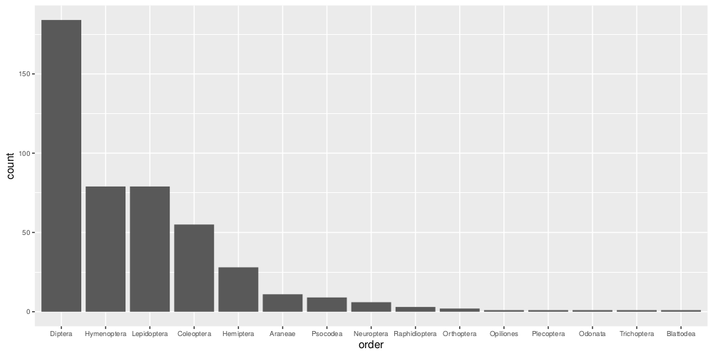
spp data overview
We get 461 invertbrate species from session 1. They belong to 15 orders. The figure shows the orders of these species and how many times each order is captured in Malaise traps.

Slide 6
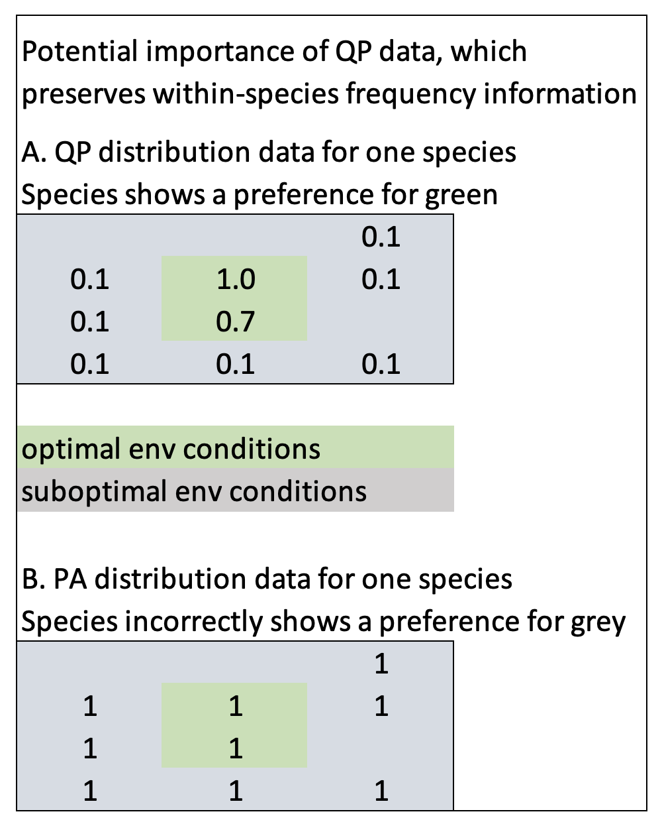
qp
I'm not sure if we'll include this table

Slide 7

sjSDM - joint species distribution model
needed in the text

Slide 8
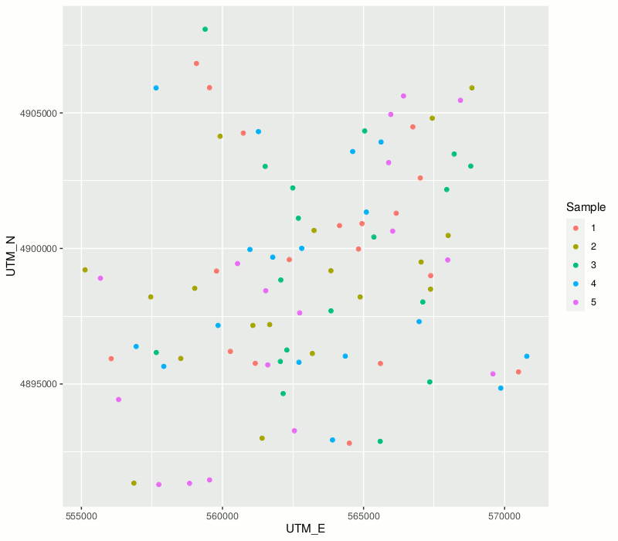
sjSDM - tuning hyper-parameters
A.
B.
1st part | 2nd part | 3rd part | 4th part | 5th part
training |  |  |  | validation
training |  |  | validation | training
......
validation | training
testing
We randomly assigned data points for Malaise trap 1 in session 1 and to 5 parts in order to tune the sjSDM models with 5-folds CV (see A). The hyper-parameters being tuned are learning rate, lambda and alpha for parts of environment, space and bio-interaction, dropout rate and hidden structure for the DNN. The tuning process involves 5-folds cross-validation on data of Malaise trap 1 (see B). Each part of the 5 folds serves as the validation set when the other 4 folds serve as the training set. After finding the best combination of hyper-parameters, we fit the models to data of all 5 folds and test the explainatable and predictive power of the model with the test set, data of Malaise trap 2 in the first session.

Slide 9
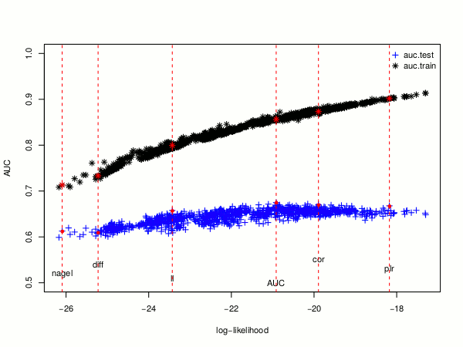
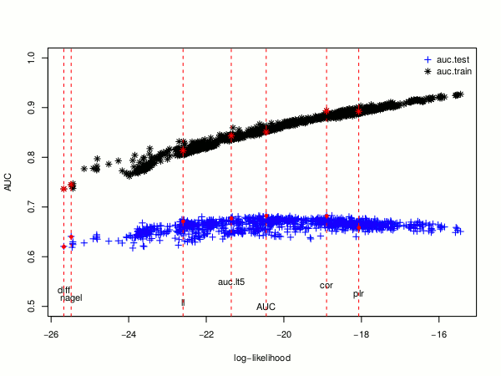
sjSDM - tuning hyper-parameters
change to auc.valid
delete other metrics
We fit the sjSDM model to both qp (left) and pa (right) data. The plots show the overview of the tuning process. We plotted the average AUC value over all species against the log-likelihood of each tuning model. For each data type, we ran 1000 models on different combinations of the tuning hyper-parameters. The black marks are the average AUC values for the training data and the blue marks for the validation data. We choose the hyper-parameter combination based on the best positive likelihood rate on the validation set.

Slide 10
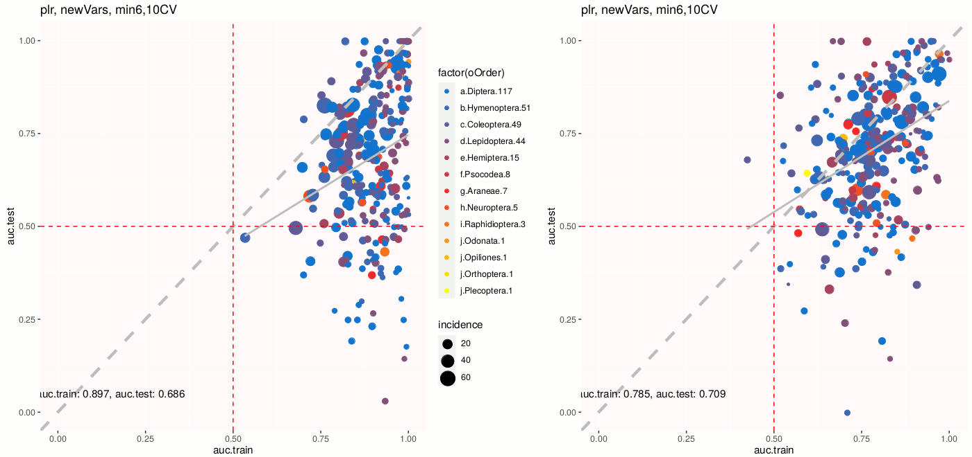
result of sjSDM
a
b
The graphs show the average auc values of each species resulted from the tuned sjSDM models. Panel a shows the model result for qp data and b for pa data. In each graph, we plot the average auc for training data against test data. Species from different oder get a different color. The average auc values for all the species are indicated on the bottomleft of the graphs.

Slide 11
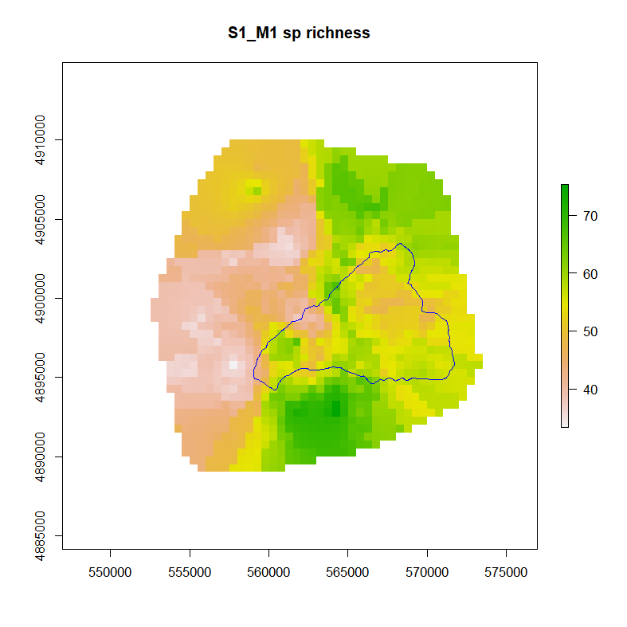
forest practice
(need these plots for predicted and observed)

Slide 12
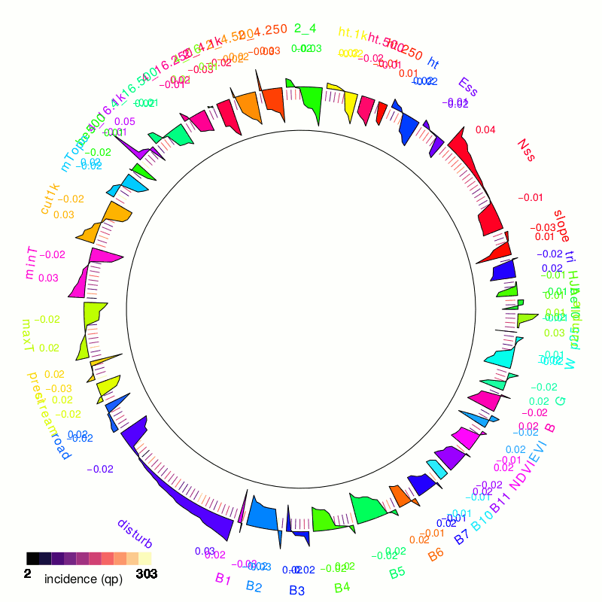
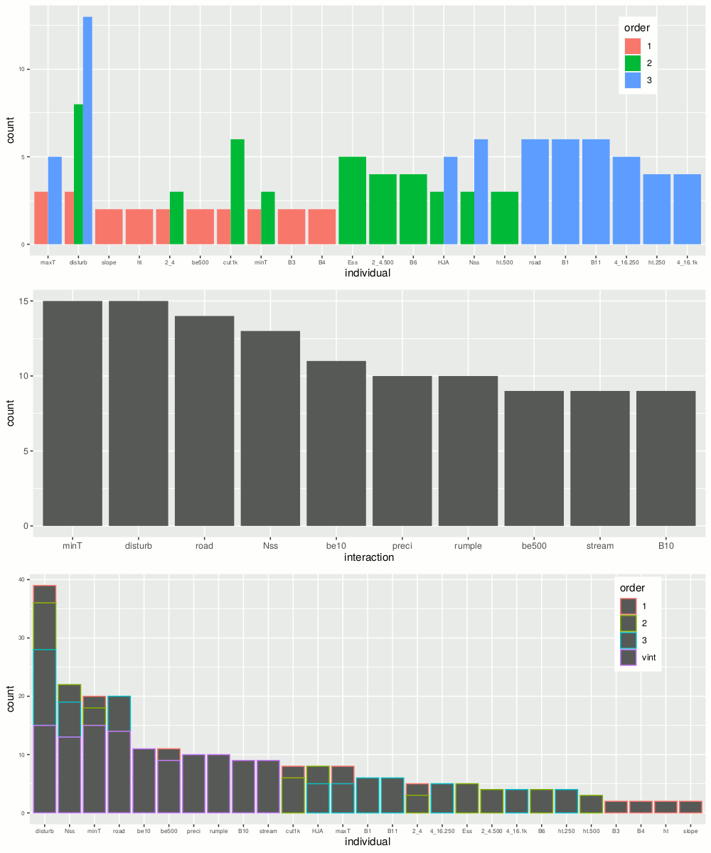
explainable AI
haven't decided how to show xAI results

Slide 13
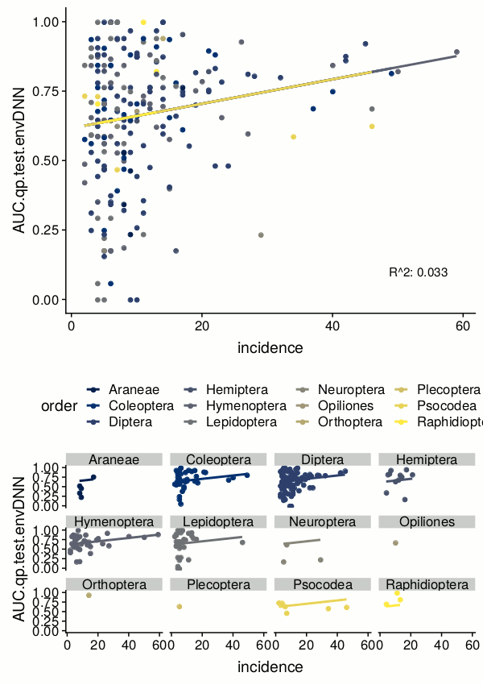
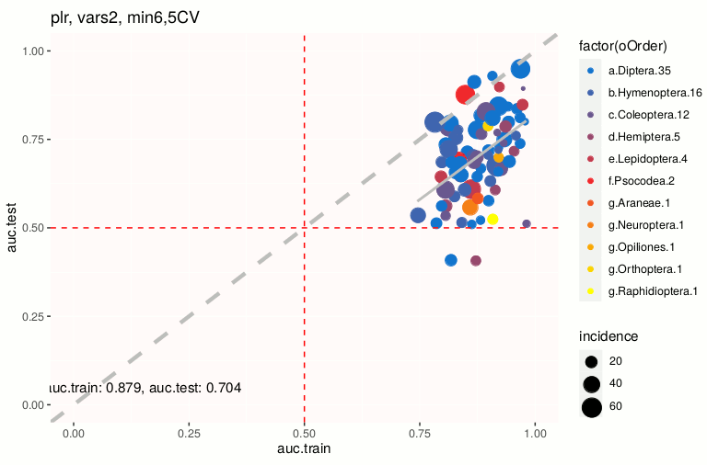
Discussion

